Slide 1



UNGA-SOCHUM
United Nations General Assembly
Discussing the global refugee problem with special emphasis on easing pressure on host countries involved and enhancing refugee self-reliance

Slide 2

UNSC
United Nations Security Council
Crisis in South Sudan with special emphasis on
extension of Arms Embargo and Adoption of Resolution 2577

Slide 3
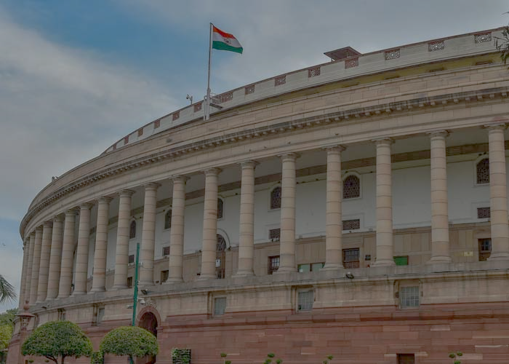

AIPPM
All India Political Parties’ Meet
Discussion on the new AGRI laws
with special emphasis on recent protests

Slide 4


UNHRC
United Nations Human Rights Council
Discussing concerns about the increased rate of Cyberbullying and Suicide with special emphasis on LGBTQ+ Community

Slide 5


UNCSW
United Nations Commission on the Status of Women
Discussing the gender inequality within sports

Slide 6
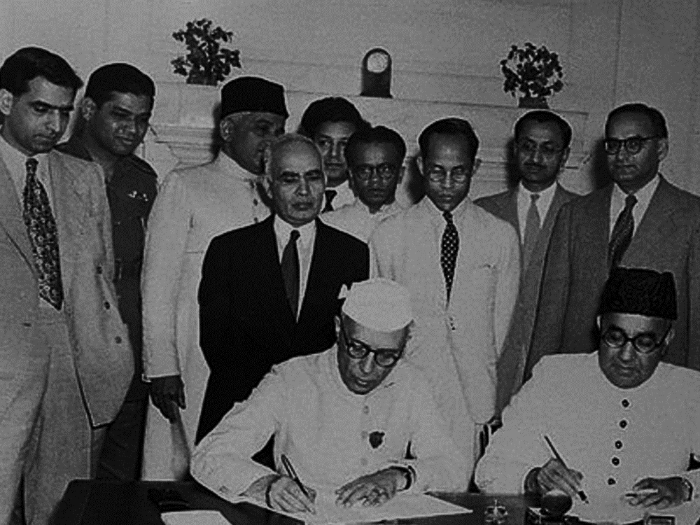
HCC
Historical Crisis Committee
Cabinet Mission Plan of 1946

Slide 7

UNCSW
United Nations Commission on the Status of Women
Discussing the gender inequality within sports

